Slide 1
10.01
Flask

Slide 2
What’s Flask?
Simply, it’s a web application framework/library. Much easier than other frameworks in this space, with far less requirements on structure. A micro-framework, of sorts
Supports:
Templates – The ability to create a more generic page that can take inputs and do something. Can also inherit from/extend from other templates.
Customized Requests – GET/POST like options.
Sessions
Command Line interface
Etc…. And supports just like any other Python program to pull in other libraries.

Slide 3
What’s a URL
https://localhost:5000/pieChart?something=X
Protocol
Host
Port
Action
Arguments

Slide 4
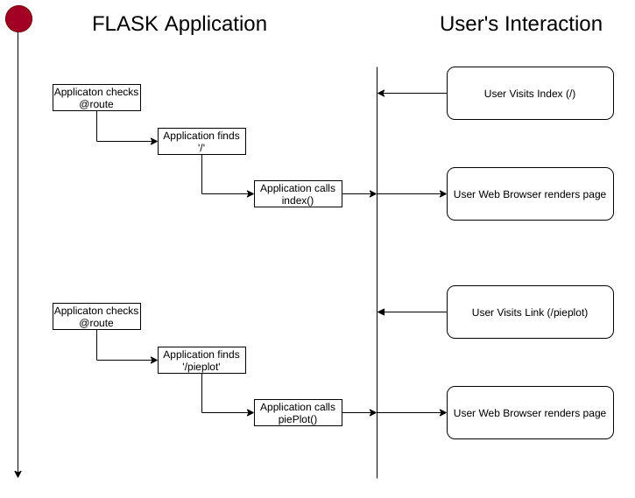
Simple Flow of Flask Application

Slide 5
Some important notes…
What you call your actions (such as index) don’t matter. There are conventions out there (index referred to as function index, or home, in many systems)
This is all PURE PYTHON, meaning no Jupyter Notebooks for any of this.

